Slide 1

Crime vs Poverty in Washington DC
Group Members: Pooja Nagrecha, Ryan Thomas, Ana Gill & Chris Krokus
Notes:
Chris
Hello and welcome to Project 1 Presentations
We are Group #3,
#2 in the presentation order
and
#1 in your hearts
My name is Chris Krokus - I am joined by Pooja, Ana, and Ryan and
tonight we are going to explore the relationship between Crime & Poverty
In our nation’s capital, Washington DC…

Slide 2
Picking a Topic
Suspect IP Addresses
Top 20 California Wildfires
Crime & Poverty
Web logs, IP addresses, error codes, geolocation… what could have been…
Purpose: Analyzing web access logs for better firewall rules.
Something Ryan may still look into...
Hundreds of thousands of acres destroyed…was it because of a drought?? was it because of high winds?? We may never know…
The wildfire dataset was not in depth and we would have had to pay $$ for OpenWeather historical data
We settled on focusing on trying to determine if there was a relationship between crime and poverty.
The year was 2017
The city was Washington D.C.
Notes:
Chris
Prior to digging into any one particular dataset, we went around and did a quick brainstorm on ideas
We began to agree on wickets that we wanted to hit to include something with coordinates (latitude and longitude) and an API…
Ideas were thrown around
Potentially looking into Avocados
Ryan mentioned something ties in closely with what he does for work
Group 3.1 was Suspect IP Addresses looking at potentially where hackers and their bots attack from
First pivot to a “highly rated” Kaggle data set on California Wildfires
Fresh off our API homework on weather and vacations
Group 3.2 was looking into how weather would play a role in the Top 20 Wildfires in California’s recorded history
There were only 20 rows of data in the “highly rated” fire dataset
Second pivot was to an idea we had heard about prior to even being introduced to our groups
We settled on Crime and Poverty
Upon further cleaining it turned out that the data sets we stumbled upon
Were specifically for Washington DC in the year 2017
…………………………….
Selim
Data World
He had his own data which was analyzing web logs
The error codes that were reported in these codes would
400 / 403 / 404 / 503 as opposed to 200 success
This data had coordinates for the IP address origin
We were looking at using MaxMind or IP Stack APIs
And it would have been neat to see where in the world the potential hackers or their bots would be attempting to access Ryan’s websites from
This was a bit tech heavy and is something Ryan is still considering looking into
We wrapped up Day 1, the only group without a proposal and we quickly through one together on Suspect IP Addresses

Slide 3

In the criminal justice system, impoverished-based offenses are considered quite normal.
In Washington D.C., the dedicated detectives who investigate these coincidences are Pooja, Ryan, Ana and Chris…
These are their stories.
Notes:
(Chris)
In the criminal justice system, impoverished-based offenses are considered quite normal.
In Washington D.C., the dedicated detectives who investigate these coincidences are Pooja, Ryan, Ana and Chris…
These are their stories.

Slide 4

Solution
Poverty and Crime
Poverty is defined by a general lack of sufficient material resources to meet the minimum needs.
Crime is a violation of the criminal law as agreed within a given jurisdiction at a particular time.
More premium subscribers
Notes:
Pooja- Poverty means being under the minimum wage of meeting requirements to afford a basic lifestyle as classified by the state government. Crime is a vioation of the law that branches out into many sub categories.

Slide 5
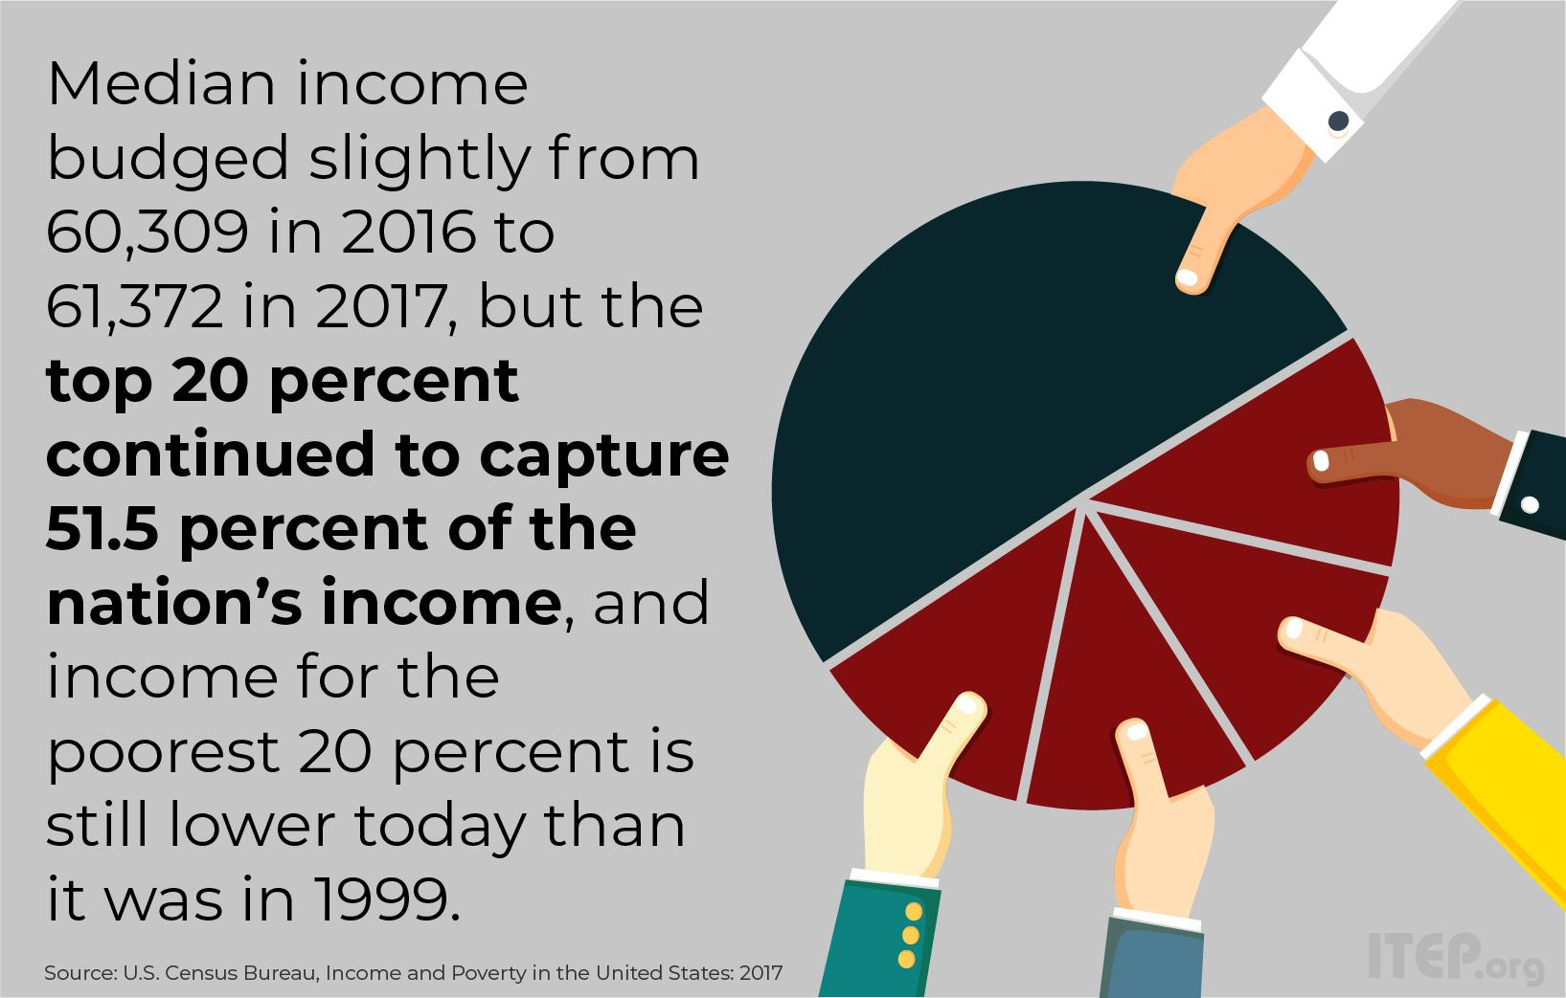
Poverty in Washington DC
The District has a higher level of income inequality than any state in the country, with households in the top 20 percent of income having 29 times more income than the bottom 20 percent.
The bottom fifth of DC households had just two percent of total DC income in 2017, while the top fifth had a staggering 51.5 percent.
Nearly one in five District residents live in poverty.
https://www.dcpolicycenter.org/publications/income-inequality-and-economic-mobility-in-d-c/#_ftn3
Notes:
Pooja- The poverty in Washington DC is very prevalent. The district has the largest income inequality gap out the whole US.

Slide 6
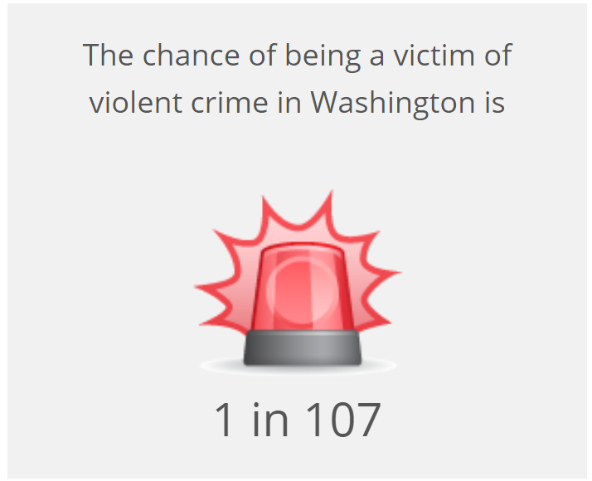
••
Washington crime rates are 102% higher than the national average.
In Washington, DC, you have a 1 in 107 chance of falling victim to a violent crime, such as rape, robbery, assault, or even murder.
In terms of property crime, your chances of being a victim are 1 in 24. These crimes include theft, vehicle theft, and burglary.
•In Washington you have a 1 in 20 chance of becoming a victim of crime
•
•https://www.areavibes.com/washington-dc/crime/
Notes:
Ryan

Slide 7
Hypothesis & Insights
Does the number of people below the poverty line in a given Census Tract affect how many crimes are committed in that area?
Questions Covered
Does a higher population affect total crime?
Will a higher percentage of poverty mean more crime in that area?
Does living in an area with little to no poverty prevent you from experiencing crime?
Identify patterns in crime over time
Which areas have the highest amount of crime?
Null Hypothesis ​H0:
There is no causal relationship between number of people below the poverty line and crime rates in a given Census Tract.
Notes:
Ryan - Just in case
If the number of people below the poverty line in a given Census Tract does not affect how many crimes are comitted in that area then for every extra 100 people in a Census Tract there will not be

Slide 8
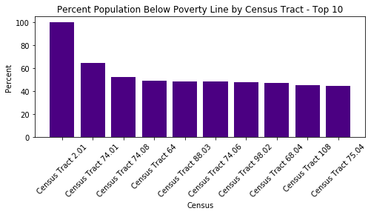
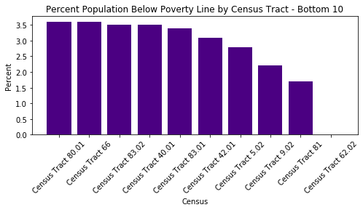
Data Exploration- Poverty Dataset
Notes:
(Chris) Census Tract - As Ryan lightly touched on, a Census Tract is a geographic region defined for the purpose of taking a census. For this data, Washington D.C. is broken up into 179 Census Tracts. This ended up being the unifying piece between our two datasets of Poverty Status and Instances of Crime, both taken from the year of 2017.
(Chris - Top Left) Top 10 poorest census tracts, the leftmost bar having 100% of its inhabitants below the poverty line. With the remainder of the bars hovering around 50% below the poverty line.
(Chris - Bottom Left) Bottom 10 poorest census tracts aka Top 10 wealthiest census tracts. NOTE the y axis goes from 0 to 3.5 as opposed to 100… One neighborhood Census Tract 62.02, actually has every inhabitant above the poverty line

Slide 9
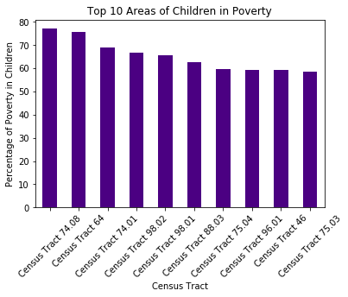
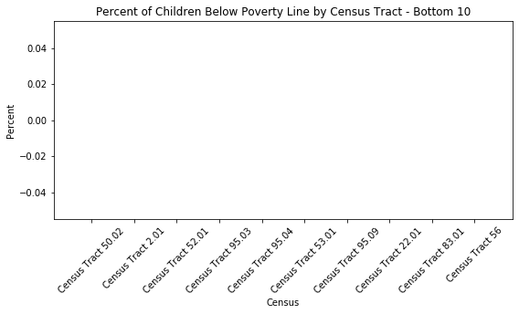
Data Exploration- Poverty Dataset
Notes:
(Chris - Left) On the left we have the Top 10 Most Impoverished Areas of DC for Children - ranging from about 55-75%
(Chris - Right) On the right, this ‘lack of bars’ bar chart displays that all of the wealthy neighborhoods have zero poor children….

Slide 10
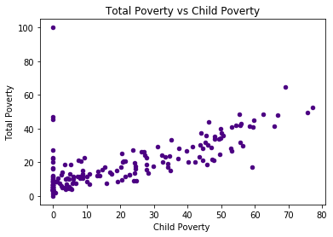
Data Exploration- Poverty Dataset
Notes:
(Pooja - Bottom Middle) Scatter Plot

Slide 11
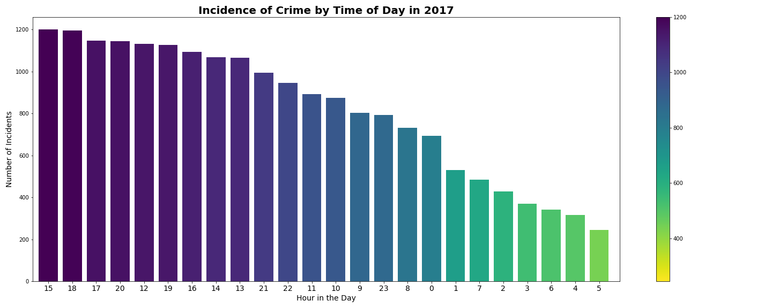
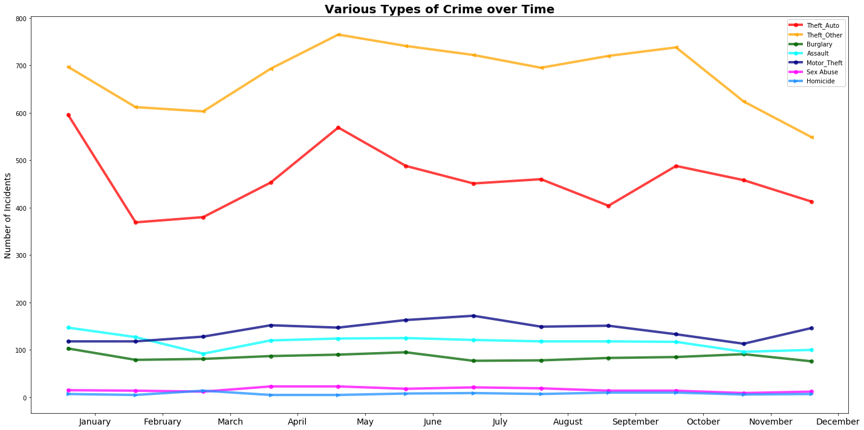
Data Exploration- Crime Dataset
Distribution over time
mostly evenly distributed over week, month and year
significant variation in the hour of the day
Theft/Auto and Theft/Other had widest range over the year
Crime Daast
Notes:
Ryan- Taking the entire year of 2017, an analysis was performed using the "Start_Date" field and aggregating over different period of time to identify a pattern. The incidence of crime remains relatively steady during the week, Over the course of the month, only the 31st day illustrated a significant drop and this like due to only 7 months having 31 days.
With respect to changes in crime volume by month, colder months (November, December, February & March) reflected low incidence of crime.
Surprising the high volumes of crime occurred at 3pm and 6pm.

Slide 12
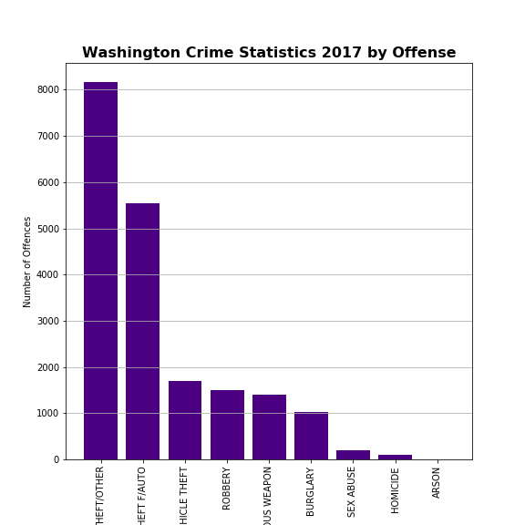
Data Exploration- Crime Dataset
Type of Crime
Theft in various forms was the most pervasive
Lower incidence of Sexual Abuse, Homicide & Arson
Notes:
Ryan- Various Forms of theft are:
THEFT/OTHER
THEFT F/AUTO
MOTOR VEHICLE THEFT
ROBBERY
BURGLARY
There are distinctions with a difference. Burlary involves illegally entering a building to commit a crime. Robbery is taking something of value with force or fear.

Slide 13
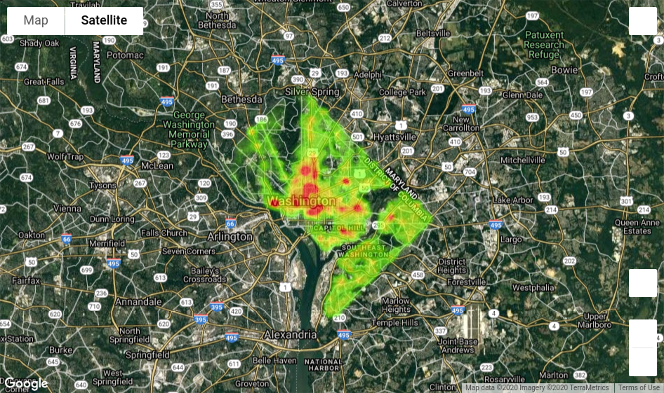
Data Exploration- Crime Dataset
Crime Daast
Incidence of crime concentrated around the city center
Notes:
Ryan- Taking the entire year of 2017, an analysis was performed using the "Start_Date" field and aggregating over different period of time to identify a pattern. The incidence of crime remains relatively steady during the week, Over the course of the month, only the 31st day illustrated a significant drop and this like due to only 7 months having 31 days.
With respect to changes in crime volume by month, colder months (November, December, February & March) reflected low incidence of crime.
Surprising the high volumes of crime occurred at 3pm and 6pm.

Slide 14
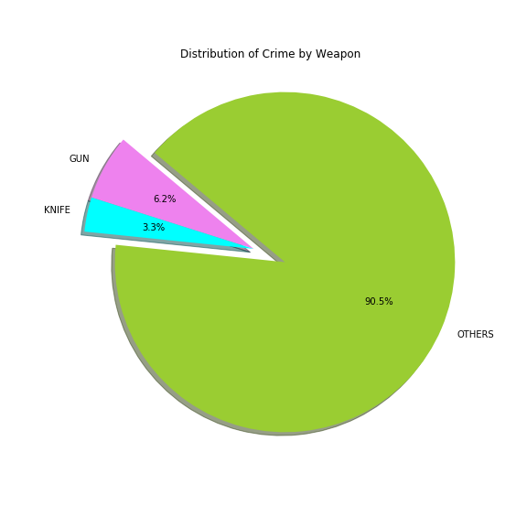
Data Exploration- Crime Dataset
Weapons
Gun & Knives were used in ~10%
Lack of granularity in this datapoint
Notes:
Ryan- This datapoint did not carry a lot of value as 90% of the data was uncategorized.
It would be more useful of more or different categories were provided.

Slide 15

Establishing whether poverty has an impact on crime
There is a widespread impression that crime is prevalent among the poor and lower social classes.
The different dimensions of the relationship between poverty and crime are dynamic and complex.
Our analysis will attempt to discover if there is a strong link between income poverty and crime in Washington DC
Notes:
Ana

Slide 16
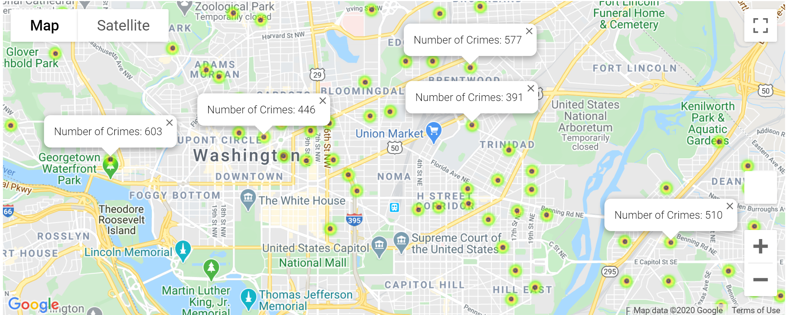
WHICH AREAS HAVE THE HIGHEST AMOUNT OF CRIME?
TOP 5 CRIME AREAS
Georgetown = 603 Offenses
Brentwood = 577 Offense
Benning = 510 Offenses
Dupont Circle = 446 Offenses
Ivy City = 391 Offenses
Notes:
Ana

Slide 17
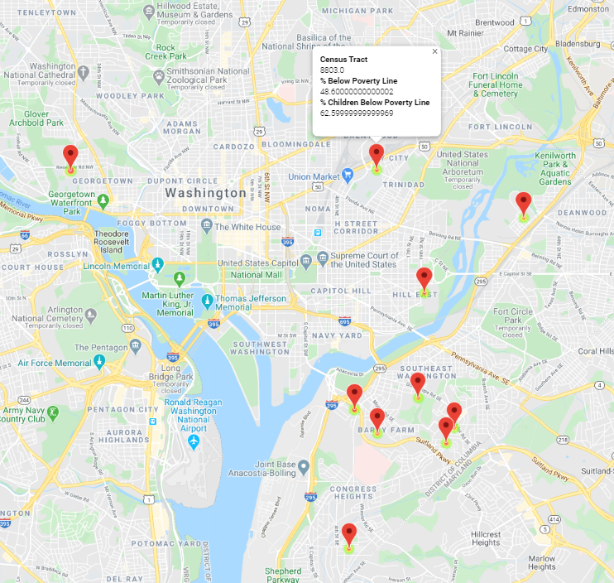
WHICH AREAS HAVE THE HIGHEST PERCENTAGE OF PEOPLE BELOW THE POVERTY LINE?
TOP 10 POOR AREAS (by %)
201-Georgetown(NW): 100%*
7401-Barry Farm rec ctr(SE): 64.6%
7408-Garfield Heights(SE): 52.6%
8803-Ivy City(NE): 48.6%
7406-Barry Farm(SE): 48.5%
9602-Mayfair(NE): 48.0%
6804-Hill East(SE): 47.0%
7504-Anacostia(SE): 45.0%
7502-Naylor Gardens(SE): 43.2%
6602-Wash. Highlands(SE): 41.9%
Notes:
Chris- Here we have the 10 poorest neighborhoods by percentage…
Washington DC is divided up into 4 quadrants with the Capitol Building at the center.
7x SE, 2x NE, 1x NW
We had gone too far before we recognized that Census Tract 201 had only 24 people in it. Of the 179 census tracts in this data set, only two others fell below 1000 people
This makes it an outlier for 2 reasons…1. For the size of the data sample…….2. For the % of people below the poverty line
In the future we would probably add the data from the three census tracts that fell below 1000 people in with a neighboring tract
This data may be of use to someone involved with planning where a Food Bank should be established….
And then be cross-compared with the previous slide to ensure you aren’t mugged after receiving food for your next meal….

Slide 18
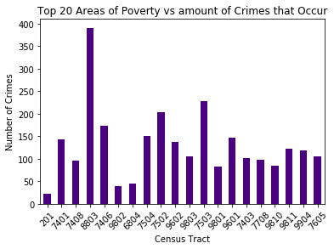
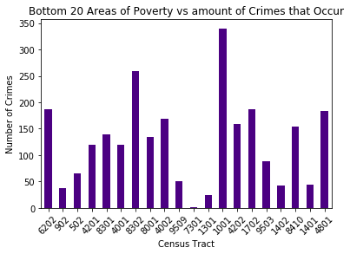
Will a higher percentage of poverty conclude more crime?
Notes:
Pooja- In this bar graph, we see that Census 201,7401, etc concludes of the highest areas of poverty. The amount of crimes that occur are similar to the amount of areas that are wealthier. We take this into account that some census’ have a smaller population leading to larger percentages of poverty.

Slide 19
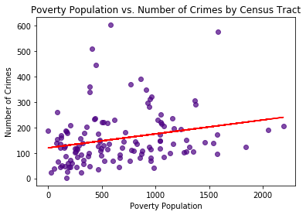
Are crimes more likely to occur in areas with higher numbers of poor people?
Poverty Population =
% Below Poverty Line X Total Population
R-Squared = .058
P-Value = .0064
Notes:
Chris- There is a significant causal relationship between poverty and crime. However, only 5.8% of the variation in crime can be explained by poverty.
Pooja will now briefly cover a similar relationship covering the Children of Washington DC
And then
Ana will follow, taking the entire population into account,
(where the variance accounted for increases slightly).

Slide 20
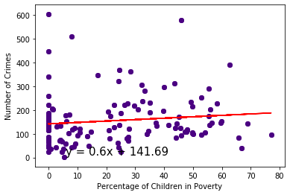
What about areas with child poverty?
The r-squared is: 0.014683560595892856
Notes:
Pooja- There is no correlation with the amount of crimes that occur and the percentage of child poverty.

Slide 21
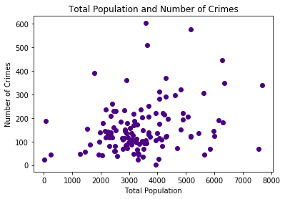
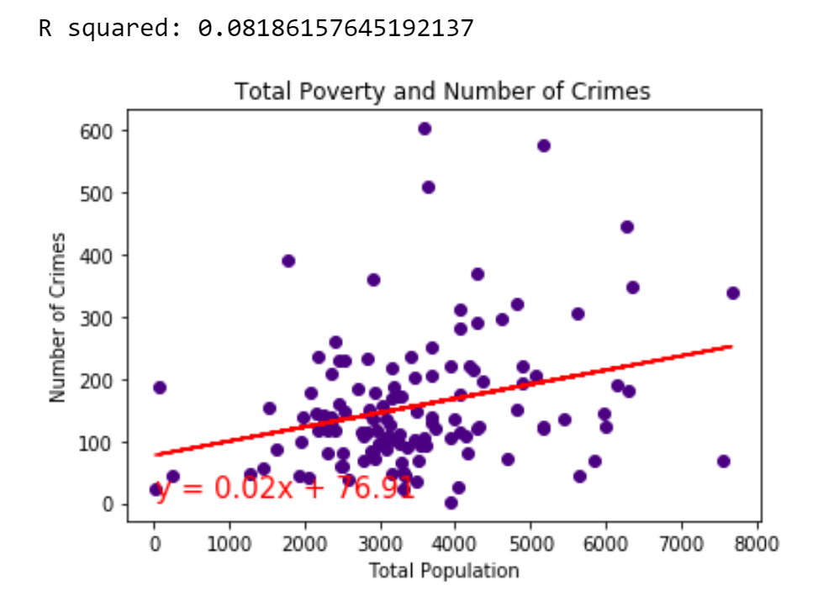
What is the strength of relationship between poverty and crime?
Weak uphill(positive) linear relationship
Notes:
Ana

Slide 22
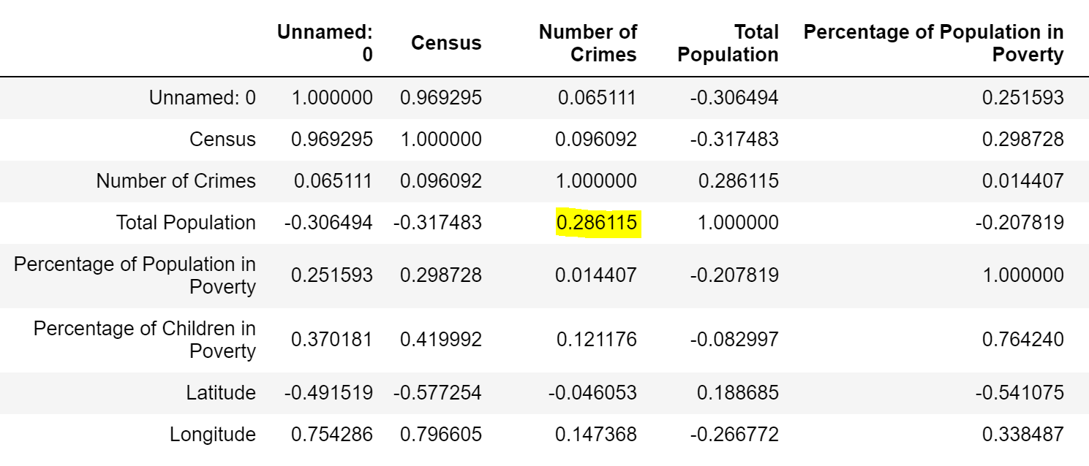
Dataset Correlation
Evaluating the validity and usefulness of the model - Total Population vs Number of Crimes
Total Population and Number of Crimes only has a correlation of 0.286 - moderately correlated.
Correlation between Total Population and Number of Crimes
Notes:
Ana

Slide 23
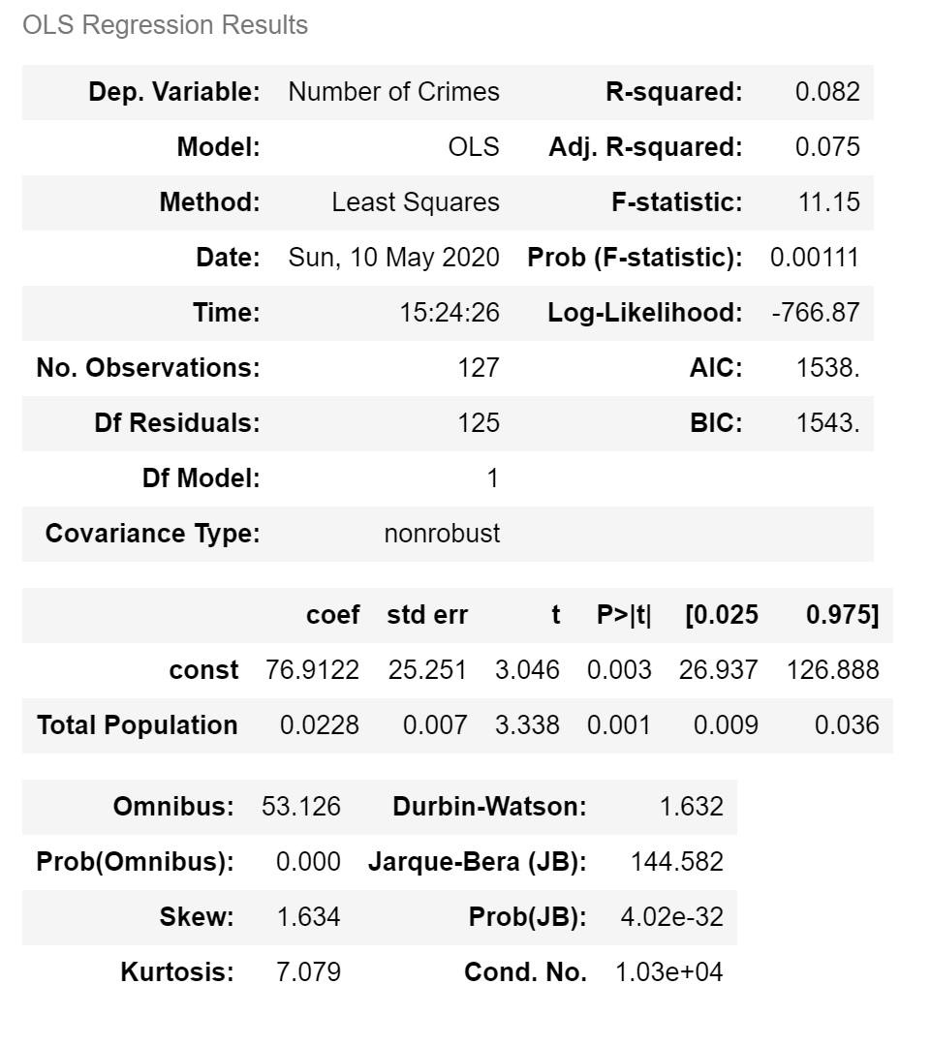
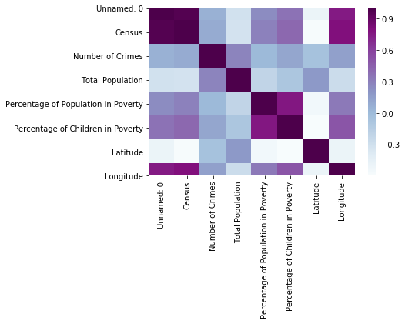
Stats model
Low R-squared (0.082) and low p-value (0.001) doesn’t explain much of variation of the data but indicates that these relationships are somewhat statistically significant.
Notes:
Ana

Slide 24
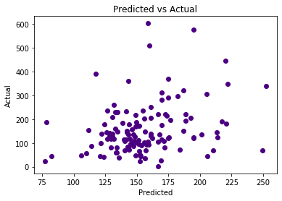
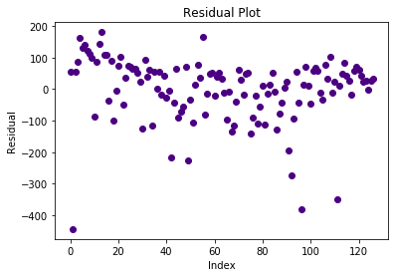
Regression analysis predicting trends and future values
Predicted 250 crimes and actual is 600
Residual plot does not show randomness
Notes:
Ana

Slide 25
Conclusions
The effect of poverty on crime is not easily captured by the suggestion that poverty alone leads to crime.
While our research shows that there is a link between poverty and crime, the link can be elusive. The variables that make up this link are many and complex.
Crime is connected to people on poverty because they are more likely to be victimized by it.
While most poor people are lawful, most criminals are poor.
Poverty may be a necessary, but there is not sufficient reason or condition that suggest it leads to crime.
Notes:
Ana

Slide 26

Summary
The outcome of our data rejects the null because the p-value is .0064. Since the p-value is less than the significance level(.05), our model fits the data well. However only 5.8% of variance by crime can be explained by poverty.
Notes:
Pooja

Slide 27

Post Mortem
Difficulties:
Finding a dataset with enough data
Finding two datasets that correlate with each other
Merging datasets
Additional Research to Pursue:
Do crimes occur more in the morning, daytime, or evening?
Does having a higher poverty rate associate with a specific type of crime?
Are wealthy areas more likely to experience burglary?
Are poor areas more likely to experience crimes of violence?
Notes:
Pooja

Slide 28

Notes:
Pooja

